Slide 1
Ads and cookies
Sam Wang APRIL 18TH 2017

Slide 2
Cookies
A cookie is a message given to a web browser by a web server.
The browser stores the message in a text file.
The message is then sent back to the server each time the browser requests a page from the server.
Notes:
It remembers your preference and you don’t have to set it everytime you logged on
IP, Location, username, languages

Slide 3
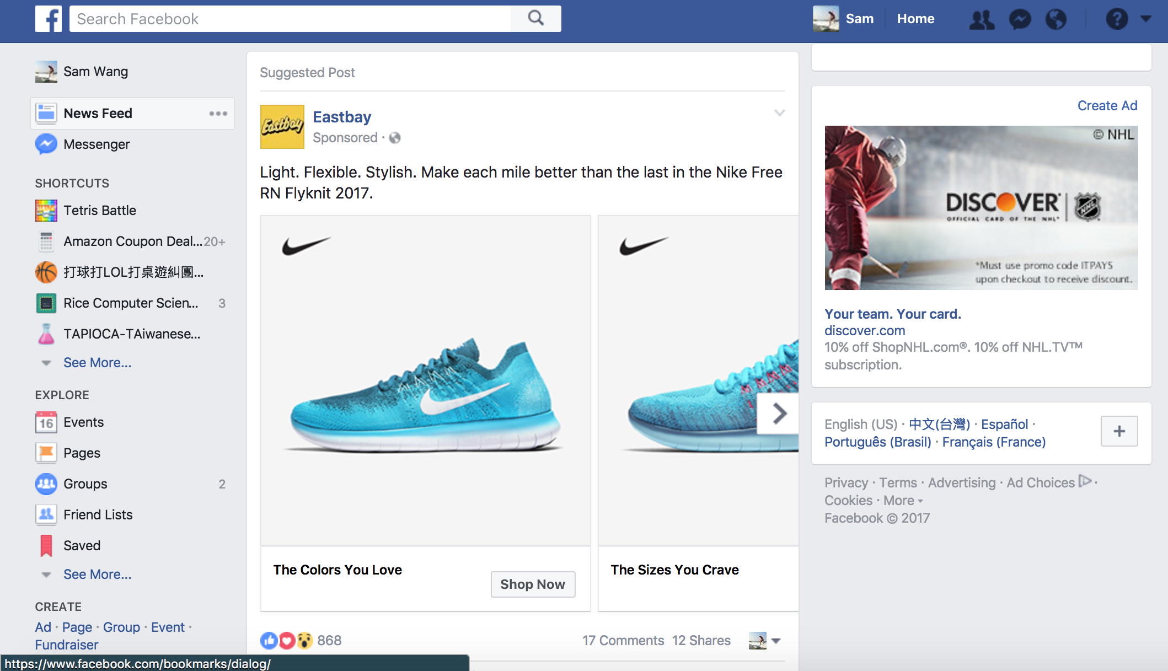
Third party cookie
Notes:
你访问过的网站会写入一些 第三方cookie 在你的浏览器里，这些 cookie 会被一些广告公司（它们就是 第三方）用来售卖更精准的广告。
比如你曾上过一家汽车网站，那你到访其他网站时可能就会看到一些汽车类的广告。就好像无论你到哪个网站去这个 广告会跟着你。这些广告比普通广告更精准，广告主乐意为他们付钱。
Eastbay has a cookie on my browser and they buy commercial from facebook. Once they detect I have cookies from the website, they displace a commercial in my newsfeed.

Slide 4
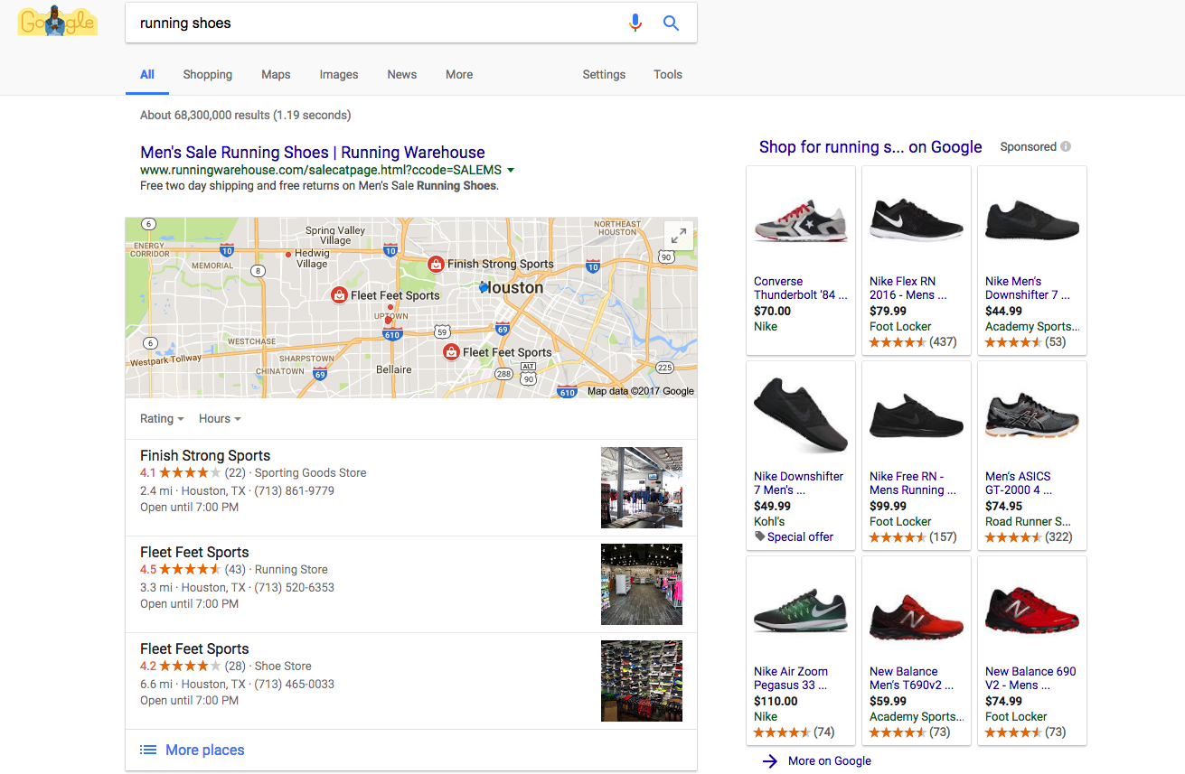
More ads
Notes:
When you link your account to
Isn’t that a little scary? How they access your history and use it for advertising? Do you feel a little bit privacy invaded?

Slide 5
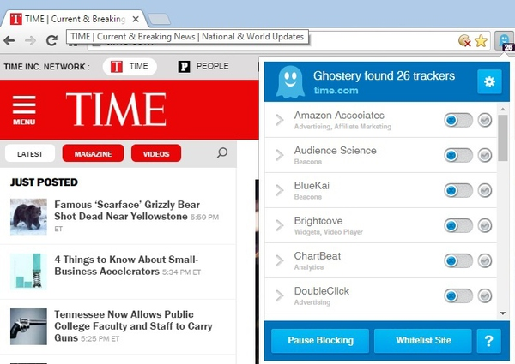
Cookie Safety
Do not track (DNT)
Adblock addons
Notes:
The Do Not Track (DNT) header is the proposed HTTP header field DNT that requests that a web application disable cross-site user tracking
Adblock blocks tracking and commercials for users
Do not track as default? The answer is simple. There is a lot of interests involved. Advertisements brings lots of revenues and the unit is in billions.

Slide 6
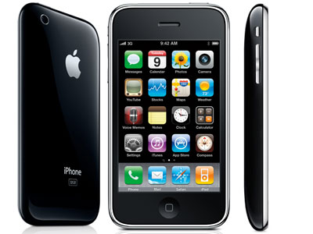
Challenge: Mobile phone
Notes:
Tablet, mobile phone ,
这种追踪方式大概在2007年iPhone上市的时候就已经走向下坡路。Apple公司开创性地禁用了iPhone中的第三方Cookie。苹果公司广告平台首席执行官Eric Litman认为，广告商可能会通过用户访问网站获取到大量的私人信息。虽然在Google的Chrome浏览器和安卓系统中，第三方Cookie仍然还在工作。但由于大量的智能机和平板电脑的使用，Cookie并没有起到什么作用。这是因为Cookie在同一台机器上并没有在浏览器与应用之间分享发送数据，因此，它们与移动设备的关联性微乎其微。

Slide 7
Thank you
Reference:
https://www.zhihu.com/question/20853596
http://www.infoq.com/cn/news/2014/10/cookie-facebook-google-apple
https://www.facebook.com/policies/cookies/
https://www.google.com/intl/zh-TW/policies/technologies/ads/

